Slide 1
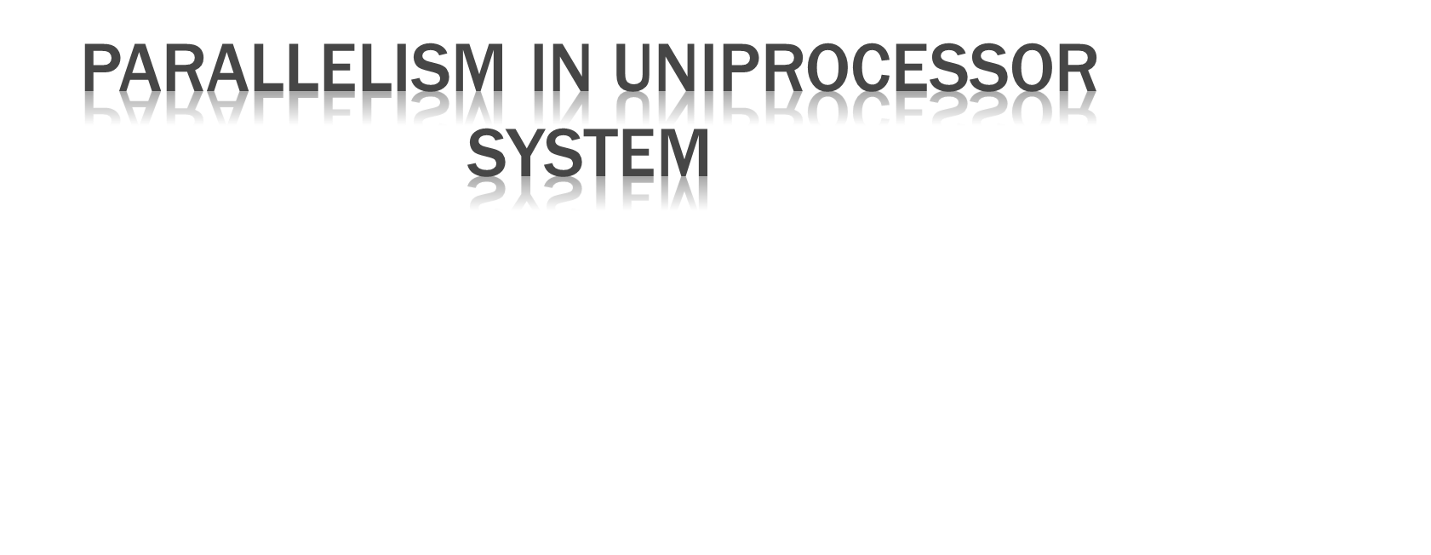

Slide 2

The typical Uniprocessor system consists of three major components:
1. Main memory,
2. Central processing unit (CPU)
3. Input-output (I/O) sub-system.

Slide 3
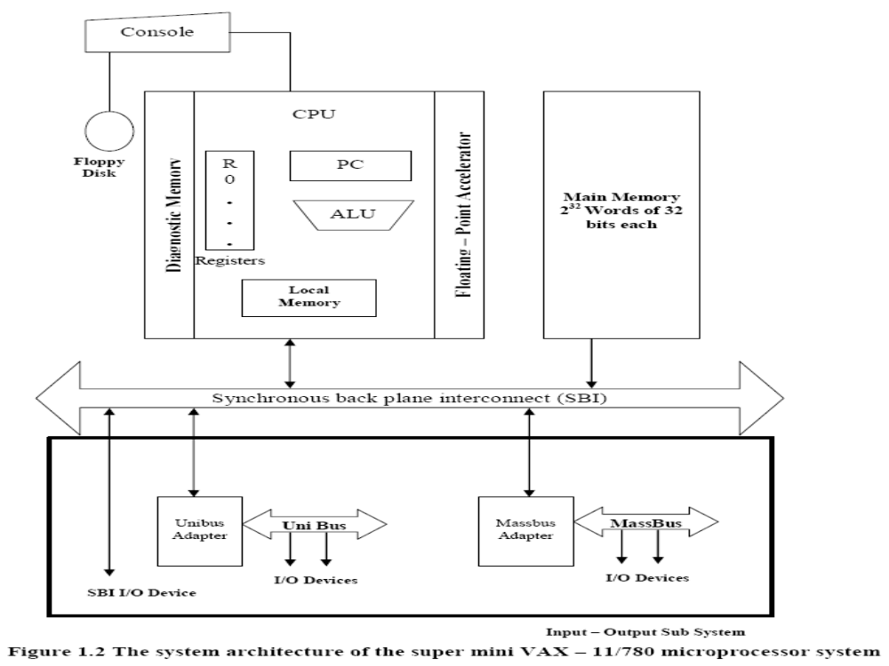

Slide 4
The CPU contains the Master Controller of the VAX system.
There are sixteen 32-bit general purpose registers, one which serve as Program Counter (PC).
There is also a special CPU status register containing information about the current state of the processor and of the program being executed.
The CPU contains an arithmetic and logic unit (ALU) with an optional floating-point accelerator, and some local cache memory with an optional diagnostic memory.
The CPU, the main memory and the I/O subsystems are all connected to a common bus, the Synchronous Backplane Interconnect (SBI) through this bus, all I/O device scan communicate with each other, with the CPU, or with the memory.
Peripheral storage or I/O devices can be connected directly to the SBI through the unibus and its controller or through a mass bus and its Controller.

Slide 5
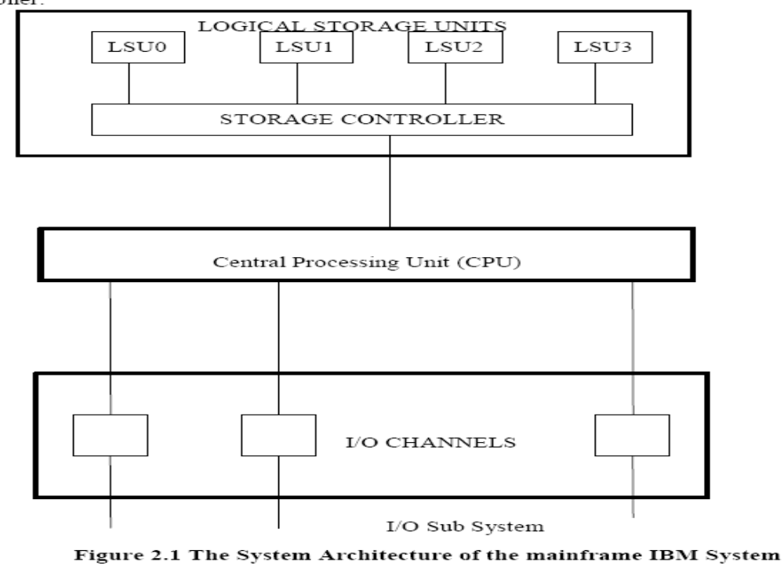
IBM System 370/model 168 Uniprocessor.

Slide 6
The CPU contains the instruction decoding and execution units as well as a cache.
Main memory is divided into four units, referred to as logical storage units that are four-way interleaved.
The storage controller provides multiport connections between the CPU and the four LSUs.
Peripherals are connected to the system via high speed I/O channels which operate asynchronously with the CPU.

Slide 7

Parallelism in uniprocessors can be achieved by the following six mechanism.
  Multiplicity of functional unit
  Parallelism and pipelining within the CPU
  Overlapped CPU and I/O operations
  Use of hierarchical memory systems
  Balancing of subsystem bandwidth
  Multiprogramming and timesharing

Slide 8

Parallel processing can be achieved in a uniprocessor system by using multiple functional units which can operate simultaneously.
CDC 6600 is having 10 functional units for performing operations in parallel.

Slide 9

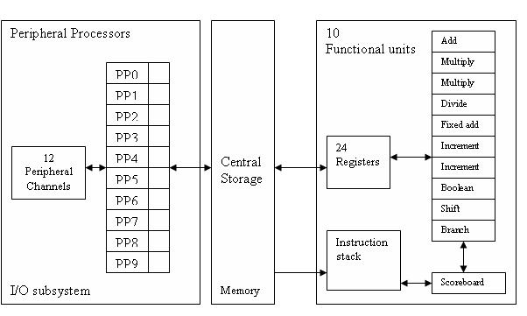

Slide 10
Parallel adders, look-ahead adders and carry save adders implemented in the CPU helps to achieve parallelism.
Instruction execution can be pipelined over many stages such as
instruction fetch, decode, operand fetch, execute and write back
which can perform the operations in an overlapped manner.

Slide 11

I/O operations can be performed simultaneously with CPU operations by using
separate I/O controllers, channels or I/O processors.
DMA channels can be used to provide direct information transfer between I/O devices and main memory

Slide 12

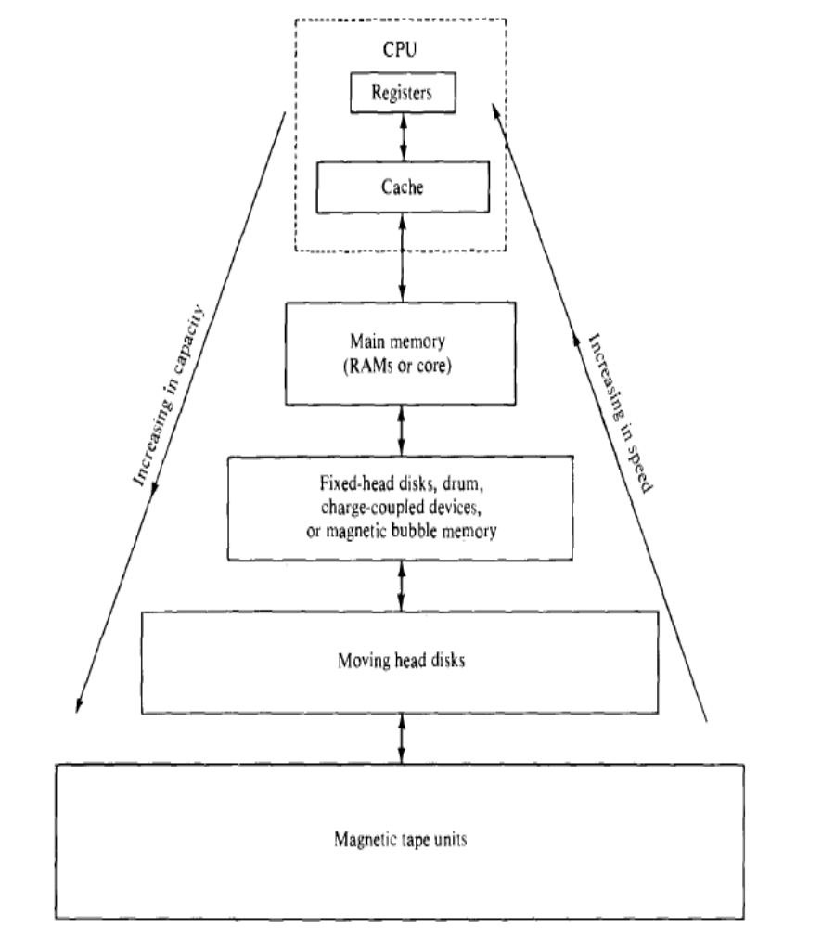
The CPU is 1000 times
faster than memory
access.
A hierarchical
memory system can be
used to close up the
speed gap

Slide 13
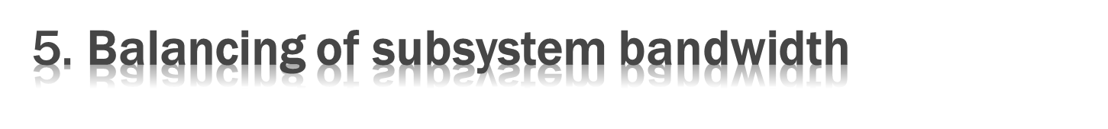
CPU is the fastest unit in computer.
The bandwidth of a system is defined as the number of operations performed per unit time.
In case of main memory the memory bandwidth is measured by the number of words that can be accessed per unit time.

Slide 14
Bandwidth Balancing Between CPU and Memory
The speed gap between the CPU and the main memory can be closed up by using fast cache memory between them.
A block of memory words is moved from the main memory into the cache so that immediate instructions can be available most of the time from the cache.
Bandwidth Balancing Between Memory and I/O Devices
Input-output channels with different speeds can be used between the slow I/O devices and the main memory.
The I/O channels perform buffering and multiplexing functions to transfer the data from multiple disks into the main memory by stealing cycles from the CPU.

Slide 15

Multiprogramming
–Mix the execution of various type of programs (I/o bound, CPU bound)
–The interleaving of CPU and I/O operations across several programs
Time-sharing OS is used to avoid high-priority programs occupying the CPU for long
–Fixed or variable time-slices are used
–Creates a concept of virtual processors

